Slide 1
Probe Data Analysis for Road Slope
Venkata Akshith Reddy Kasireddy (A20455209)
Sai Vishal Kodimela (A20453006)
Nikhil Sarika (A20470289)
Souporno Ghosh (A20439047)

Slide 2
Contents
Introduction
Problem Statement
Task
Obtained Results
References

Slide 3
Introduction
What is Probe Data ?
It is data which is generated by monitoring the position of moving objects over space and time. These moving objects can be dedicated vehicles used to collect information.
The individual probe points consist of ProbeID, dateTime, sourceCode, latitude, longitude, altitude, speed, heading etc.,
When receiving probe data from cars, especially in urban areas the GPS data is off the road path due to satellite signal deflection by tall buildings.
To increase the accuracy of the current road network, the incoming probe data must be matched to the right “link” in the road network.

Slide 4
What is Link Data?
Link is usually a set of GPS coordinates which can be used to either constitute a road curve or indicate a road segment.
Whereas, Link data is termed as a information of road segments (links).
Link data consist of data for the links that probe points can be map-matched to.
It consist of linkPVID, direction of Travel etc

Slide 5
Problem Statement
Input: Probe data map
The raw probe points collected over several months
The link data for the links that probe points can be map-matched to following output tasks.
Output:
Map match probe points to road links
Derive road slope for each road link
Evaluate the derived road slope with the surveyed road slope in the link data file.

Slide 6
TASK - Part One: Map Matching
Latitude and Longitude are given in both Probe Data and Link Data.
To Map- Match we use these Latitude and Longitude information of both these files and compare them with every other to find the one-pair with minimum distance between them.
This pair is resultant Map-Matched Probe data points to corresponding Link.

Slide 7
TASK - Part Two: Slope Derivation
To calculate the slope between two points here we use the matched points from previous step to calculate the slope of two consecutive points.
The slope between two consecutive points (P1, P2) is = 𝑅𝐼𝑆𝐸/𝑅𝑈𝑁 𝑖.𝑒. (𝑌2−𝑌1)/(𝑋2−𝑋1), where p1(x1,y1) p2(x2,y2) are two points.
2. Calculate for all the matched points.

Slide 8
TASK - Part Three: Compare
Evaluating derived road slope with surveyed road slope
Average of slope is calculated for each Link data.
This slope is then compared with the slope we calculated in previous step.

Slide 9
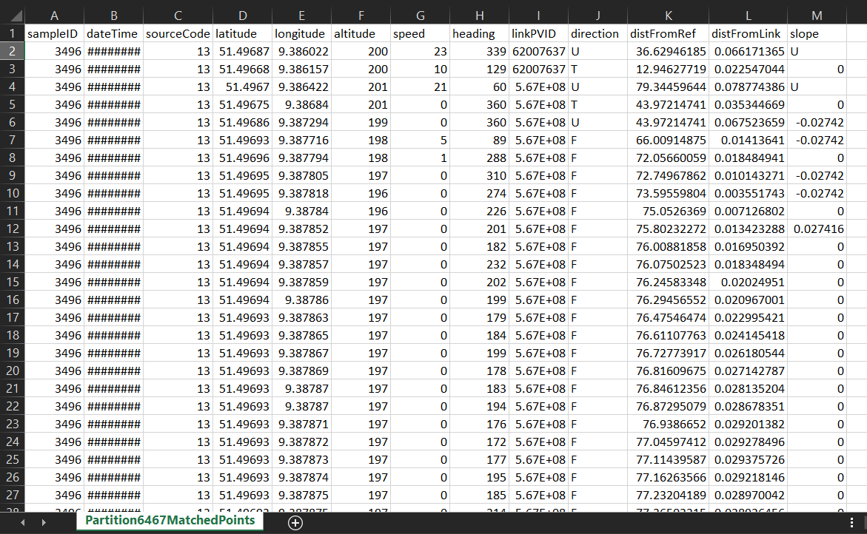
Obtained Results
MatchedPoints.csv:

Slide 10
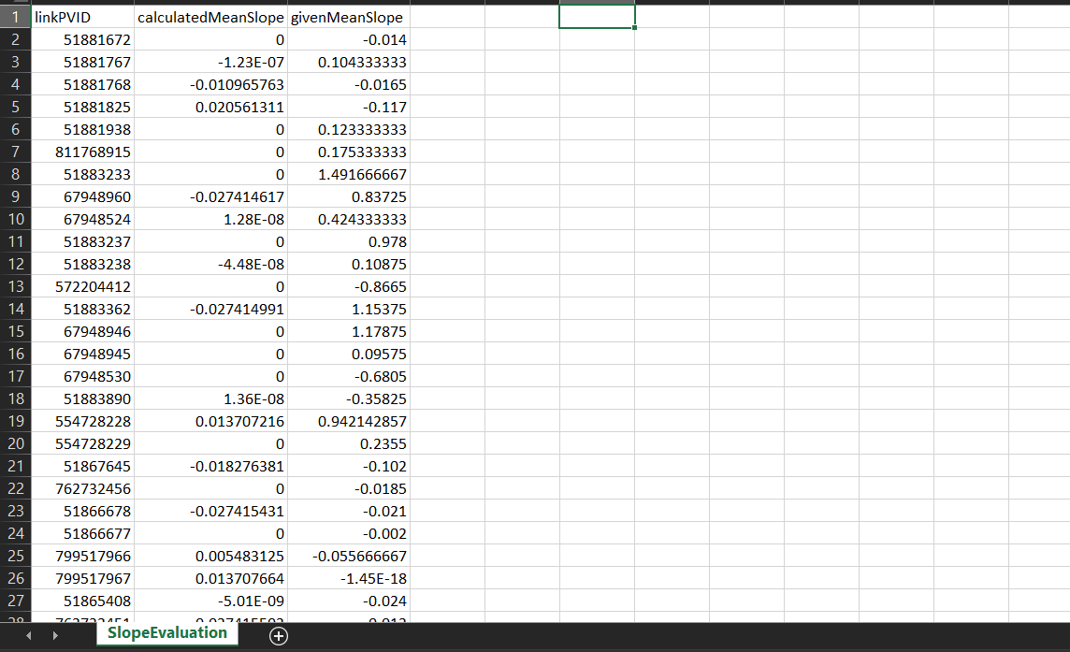
EvaluatedRoadSlope.csv:

Slide 11
References
“Online map-matching based on Hidden Markov model for real-time traffic sensing applications” by C.Y. Goh, J. Dauwels, N. Mitrovic, M. T. Asif, A. Oran, P. Jaillet (2012 ITSC).
“Map-Matching for Low-Sampling-Rate GPS Trajectories” Yu Zheng, MS Research.

